Slide 1
DSL Productization
Anuparna Ganguly
23/06/2025

Slide 2
Agenda
Recap
Implemented Suggestion
This Week’s Progress.
Input & Output
Next steps/ Plan
Demonstration

Slide 3
Recap of Previous Work
Used Parser to extract:
Node name
Node attribute values
Source and destination primitives from edges
Used Symbol Table to :
Store all created Nodes with type
Check if connections between nodes are valid or not.
Created Junction(“Junc”) between source and destination:
Helps to connect primitives
Store necessary data
Used during backtracking,forward pass, and backward pass in the analytical model

Slide 4
Agenda
Recap
Implemented Suggestion
This Week’s Progress.
Input & Output
Next steps/ Plan
Demonstration

Slide 5
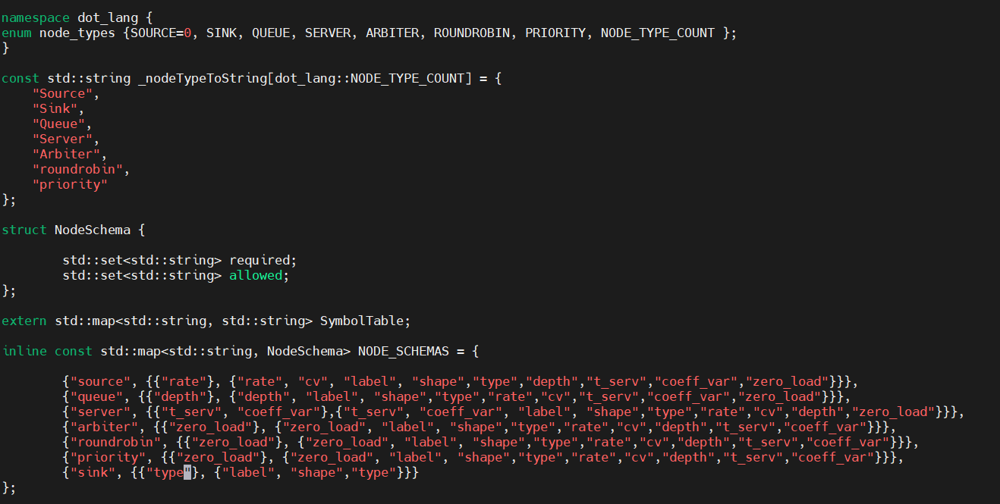

Suggested Improvement(Implemented)
Removed restriction on attribute field.
Now you can write attributes more flexibly like:
Injector[type=source,
rate=0.2, t_cap=1, depth = 3]
Allowed attributes list updated
Code updated accordingly

Slide 6
Agenda
Recap
Implemented Suggestion
This Week’s Progress.
Input & Output
Next steps/ Plan
Demonstration

Slide 7
Key Updates & Fixes
Resolved errors related to dot_lang class members
Fixed Segmentation fault errors
Enhanced flexibility by updating allowed attributes
Added two more type attributes.
RoundRobin
Priority
Modified codebase to support the new attributes.
Created and integrated Sink.h/.cpp file.
Modularized code further by adding new header/source files.

Slide 8
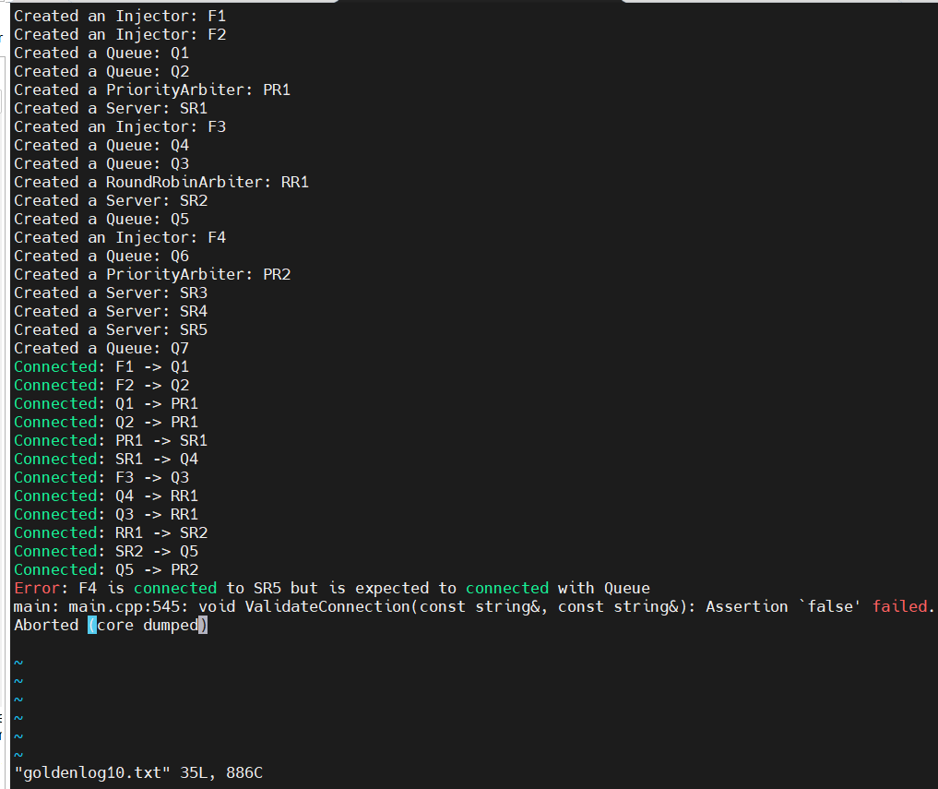
Generated goldenlog.txt
Usual Configs:
RR after PR
PR after RR
RR after RR
PR after PR
Complex configurations(like RR followed by PR and that PR followed by PR/RR)
Injector is connected to Server
Source/Destination not declared.

Slide 9
Agenda
Recap
Implemented Suggestion
This Week’s Progress.
Input & Output
Next steps/ Plan
Demonstration

Slide 10
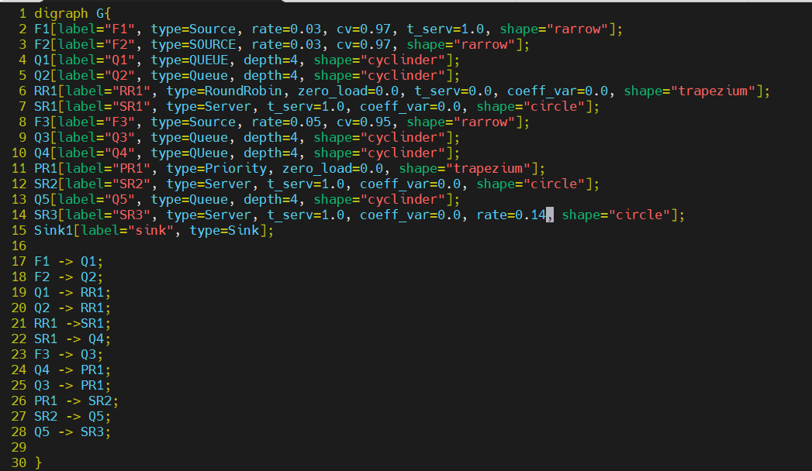
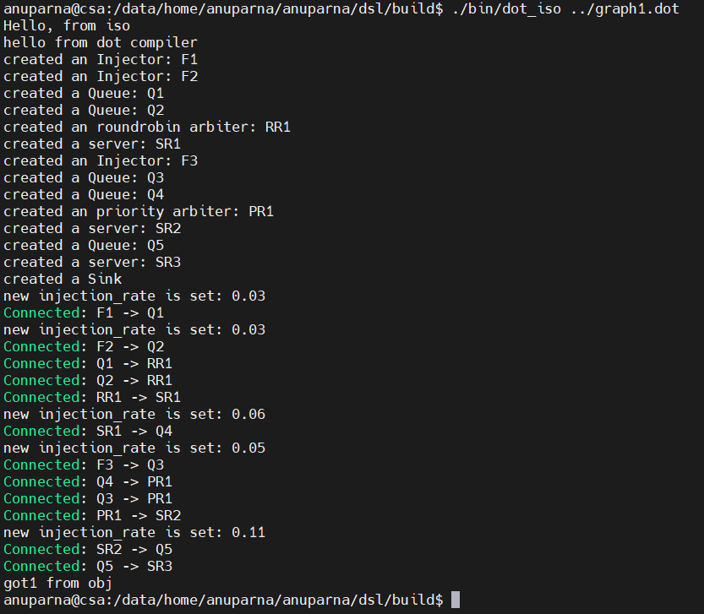
Execution Result and Generated Output
Extra Attribute

Slide 11
Agenda
Recap
Implemented Suggestion
This Week’s Progress.
Input & Output
Next steps/ Plan
Demonstration

Slide 12
Future Work
Verify the connection to the Analytical Model
Compare the results with previous goldenLog files.

Slide 13
Agenda
Recap
Implemented Suggestion
This Week’s Progress.
Input & Output
Next steps/ Plan
Demonstration

